Slide 1

TESLA Stock Data
Dr. Nawana Coyle

Slide 2

TESLA Stock Data
Problem
Looking at previous data in a given timeframe, can we predict the adjusted closing price for TELSA stocks?

Slide 3
Why Adjusted Closing Price is important?
Adjusted closing price looks at - dividends
stock splits
new stock offerings
It begins where the closing price ends – Therefore, it’s a more accurate measure of stock’s value
Helps investors evaluate the value of the stock quickly.
Help compare stocks, especially in long term investments

Slide 4

Why is Predicting Adjusted Closing value important?
Cars with clean energy is the focus of the future.
The popularity of electric cars have risen significantly which indicate larger sales in future.
More sales generally increases the stock values, which is shown in Tesla stock prices.
Predicting better stock values gets more investors interested in investing in the product.

Slide 5
Data for the project
Original data for this project came from Kaggle.com at
https://www.kaggle.com/datasets/varpit94/tesla-stock-data-updated-till-28jun2021

Slide 6

Data Cleaning
Use pase_dates → convert the custom formatted date string to a standard formatted data string
No missing values → No need to fill
Apply toordinal() function to change the datetime dataset into an integer for fitting models.

Slide 7
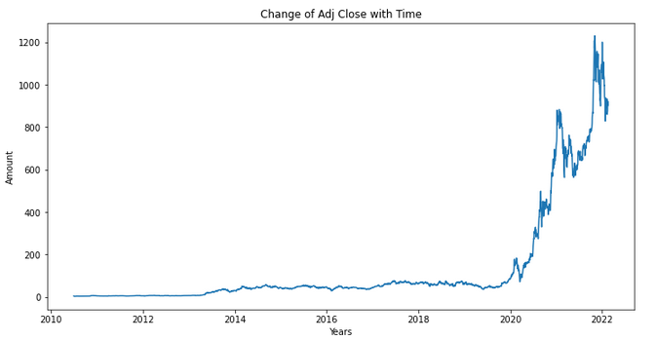
Exploratory data analysis (eda)
.info() → All data are of numeric data types
No missing values
There’s a significant degree of increase in the adjusted closing price since 2020 → increase in interest in investing in Tesla ???

Slide 8
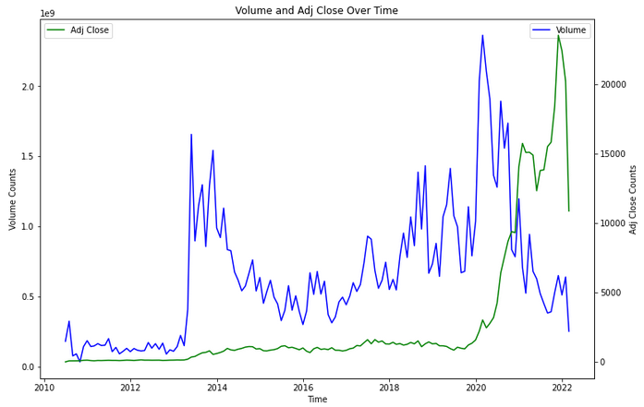
Eda Continued…
The volume of sales have an increased significantly at the beginning of 2020.
The adjusted closing price gets a significant increase in January in 2021 and January 2022.

Slide 9
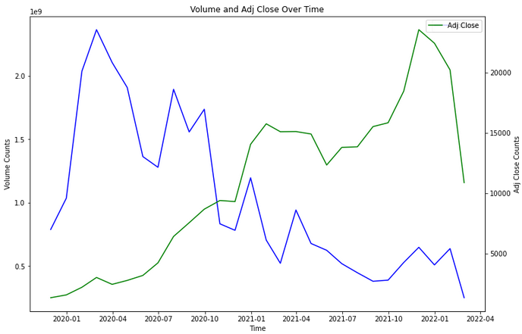
Eda Continued…
First quarter of 2020 seems to have the highest volume of sales.
Adjusted closing price in the 1st quarter of 2020 was comparatively low.
In 1st quarter of 2020→ Sales → Investor interest → Stock prices of Tesla ???

Slide 10
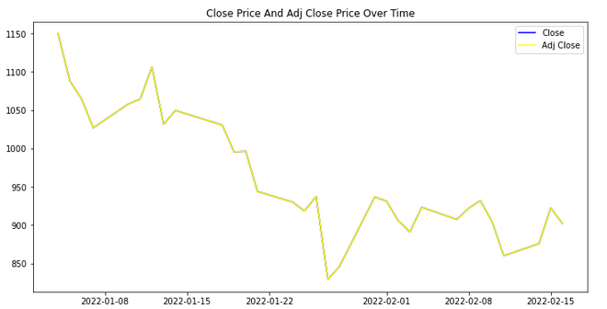
Eda Continued…
Adjusted closing price is calculated taking closing price, stock splits, dividends and new stock offerings into considerations.
Stock splits, dividends and new stock offerings brings the adjusted closing price down.
According the graph, the adjusted closing price is the same as its closing price for Tesla stocks.
Are there no negative factors which affects the Tesla stock values after closing, which makes it more attractive to investors which explains stock price going up in the recent 2 years ???

Slide 11
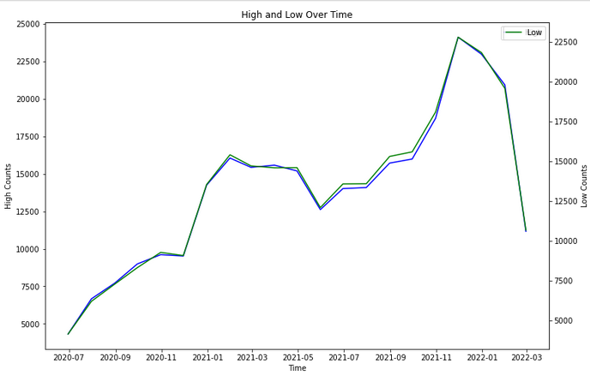
EDA continued…
High: maximum price in a trading day
Low : minimum price in a trading day
The shape of sales of each line is very similar → The number of items sold with highest and lowest prices for each month are similar.

Slide 12

Data modeling
Models used for the project:
RandomForestRegressor
Tuned RandomForestRegressor
TWeedieRegressor
Ridge Model

Slide 13

Why choose Randomforestregressor?
Simple, highly accurate and easy to use to predict values.
Uses ensemble learning method which combines predictions from multiple machine learning algorithms to make predictions more accurate.
Easier to tune hyperparameters during experimentations, and scales well if new features are added to the dataset.

Slide 14

Why Tune Paramaters?
Mean_absolute_error (MAE) is a good indication for evaluating RandomForestRegressor model.
Tuning will help choose specific parameters which can make an impact on the predictions.
The MAE could be a great metric which could indicate if RandomRorestRegressor or the tuned RandomRorestRegressor model did better in predicting the data.

Slide 15
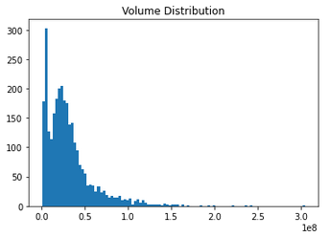
Why choose tweedieregressor?
Data show a tweedie distribution, and TweedieRegressor will do great in analyzing data.
(Number of units sold a day show a tweedie distribution)
This model gives the flexibility to be customized depending on the distribution using the power parameter.
p = 0 : Normal distribution
p = 1: Poisson distribution
1 < p < 2: Compound Poisson/gamma distribution,
p = 2: gamma distribution etc.

Slide 16
Why choose
Ridge model?
This model helps regularize coefficient estimates, and bringing the coefficients close to 0 which works better with new data.
Solve the problems associated with overfitting – calculates the squared error differences between the predicted value and actual labels
Many independent variables in the dataset has high intercorrelation - multicollinearity
E.g.: closing price and adjusted closing price
Highest and lowest sales prices of items on a given day

Slide 17
Modeling
1 Splitting data
2 methods of data splitting were used to understand which dataset would do better in making predictions:
First 70% of data as training dataset and remainder as test dataset
Randomly chosen 70% of data as training set with train_test_split () function
Mean_absolute_error (MAE) metric was used to evaluate both datasets.
Observation:
Randomly split dataset using train_test_split() function did much better than the other.
MAE 0.6847 vs 73629.6424
Conclusion:
Since there is a significant degree of elevation in the graph later in years, compared to the first 8 years, randomly chosen dataset provided much better results.

Slide 18
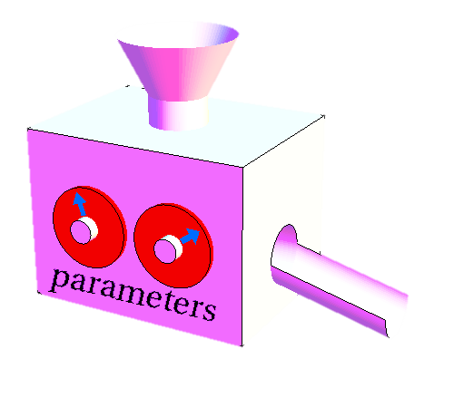
Modeling Continues…
2. Hyperparameter tuning
A grid was created with parameters that needed to be tuned.
grid = {'n_estimators': np.arange(10,100,10),
'max_depth': [None, 3,5,10],
'min_samples_split': np.arange(2,20,2),
'min_samples_leaf': np.arange(1,20,2),
'max_features': [0.5, 1, 'sqrt', 'auto']}
b) Initiated RandomizedSearchCV with param_distributions = grid
c) Get the best parameters with model.best_params_
d) Assign the best parameters to the model.

Slide 19
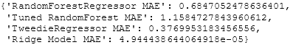
Modeling Continues…
3. Calculating mean_absolute_error (MAE) for all models
Created a function to calculate all 4 models: score_models()
Created an empty dictionary to save the scores of all: model_scores = { }
Created an empty dictionary to save all predictions the models made: all_predictions = { }
Run the score_models() function
Results:

Slide 20
Evaluating models
Ridge MAE < TweedieRegressor MAE, RandomForest MAE, tuned RF MAE
Ridge model has the lowest MAE, followed by RandomForestRegressor

Slide 21
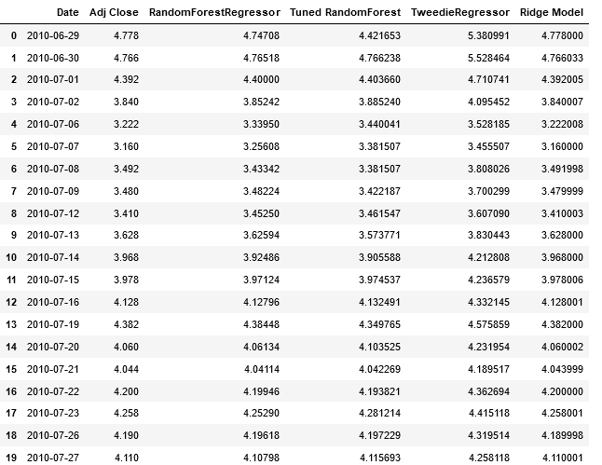
Predictions made by the models

Slide 22
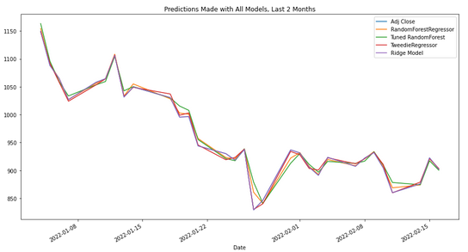
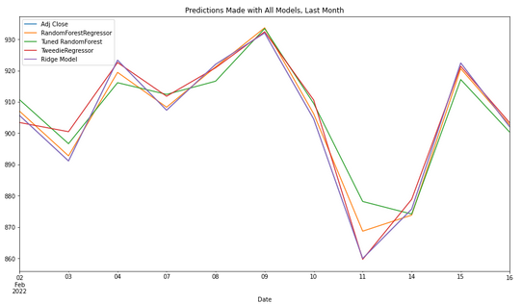
Evaluating models Continues…
Looking at data for the last month and 2 month time, ridge model comes very close to the actual adjusted closing price of Tesla stocks, compared to other models.
RandomForestRegressor comes second.

Slide 23
Summary of the project
Problem
Looking at previous data in a given timeframe, can we predict the adjusted closing price for TELSA stocks?
Findings
In 1st quarter of 2020→ Sales → Investor interest → Stock prices of Tesla ???
Are there no negative factors which affects the Tesla stock values after closing, which makes it more attractive to investors which explains stock price going up in the recent 2 years ???
Number of items sold with highest and lowest prices for each month are similar.
Results
Ridge regression makes the best predictions, then RandomForestRegressor

Slide 24
Areas for improvements
Try different parameters to tune in RandomForestRegressor
Entertain other regression models
Collect more data variables other than the 7 variables provided.
Get clarity on how adjusted closing price for Tesla is calculated and determine if other factors play a role in determining the pricing.
Conduct more experimentations with hyperparameter running for both Ridge regression and Random Forest Regression

Slide 25
Thank you!

